Slide 1
Genomic Random Interval version 2.0
Stan Pounds
October 5 & 7, 2022

Slide 2
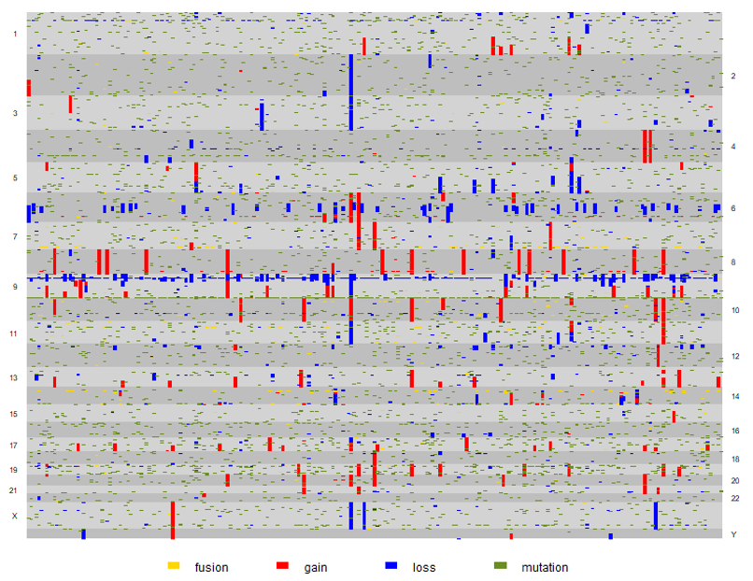
Genomic Lesion Data
Location and Type of Genomic Lesions in Multiple Tumors
What loci (genes) are impacted more frequently than by chance alone?
Genomic Random Interval Model
Models the location of lesions due to chance.
Performs formal hypothesis tests to evaluate the statistical significance of the observed frequency of lesions at each locus (gene).

Slide 3


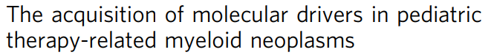

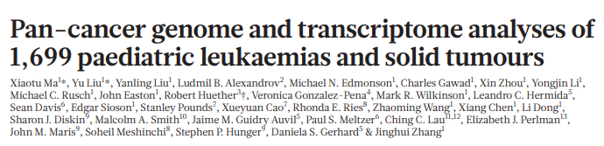
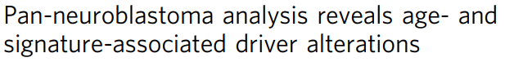
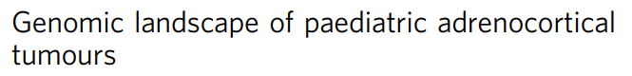





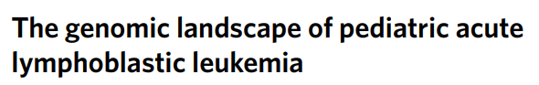
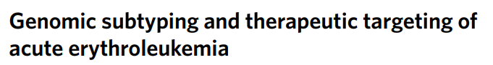
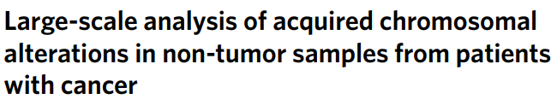

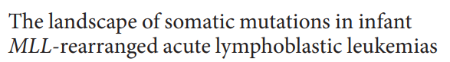

Slide 4





MuSIC
GISTIC
GRIN
GRIN 2.0
Mutations
Increase Compute Speed > 100 fold
Gain/Loss/LOH
Fusions
Constellations
Simplified Programmer Interface
Expression
Clinical

Slide 5
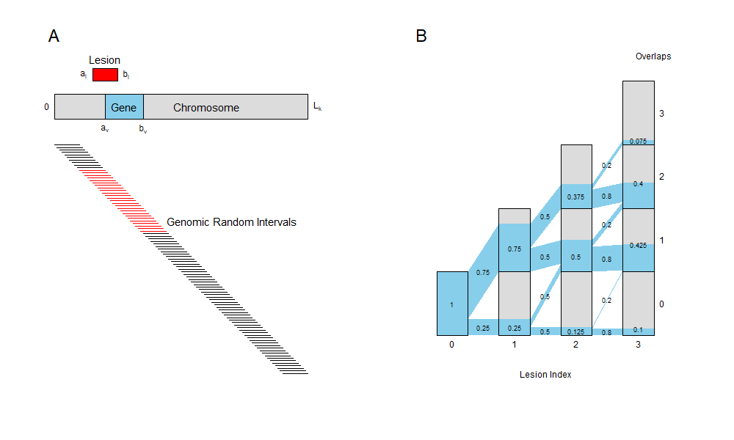
Pr₀(k lesions hits gene) = Convolution of
non-identical
Bernoulli RVs
gene size + lesion size - 1
chromosome size
Pr₀(lesion hits gene) =

Slide 6
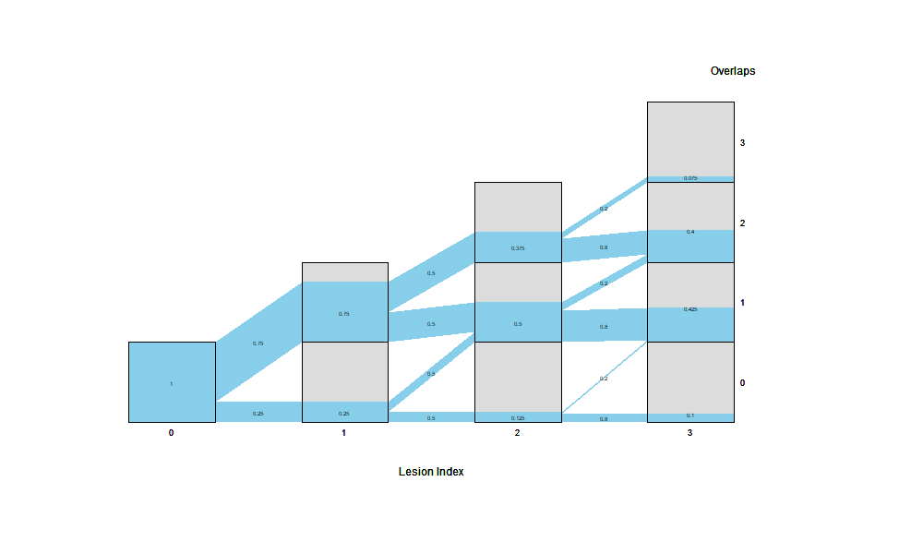
Pr₀(hit) for each of 3 lesions
0.75 0.50 0.20
P-values
Pr₀(≥ 3 hits) = 0.075
Pr₀(≥ 2 hits) = 0.475
Pr₀(≥ 1 hits) = 0.900
Pr₀(≥ 0 hits) = 1.000

Slide 7
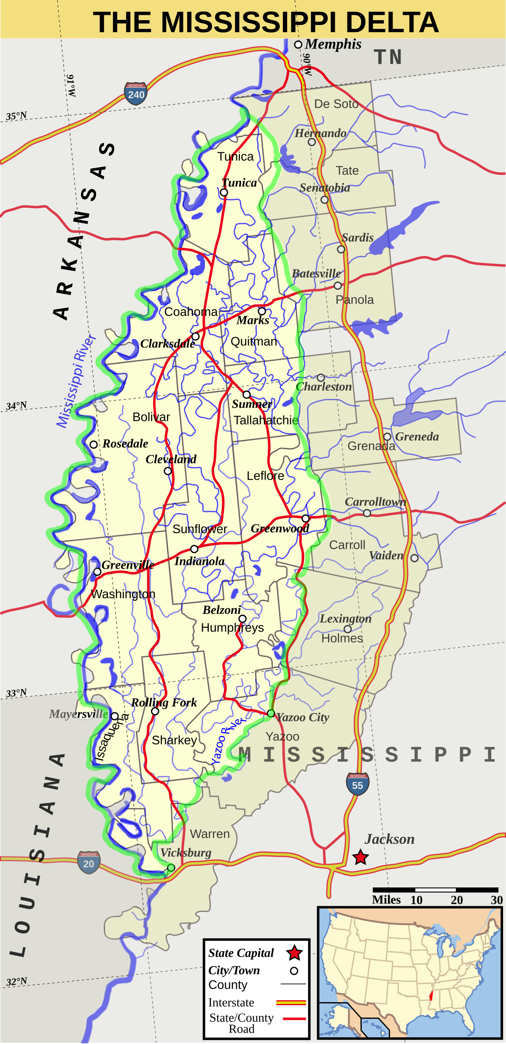
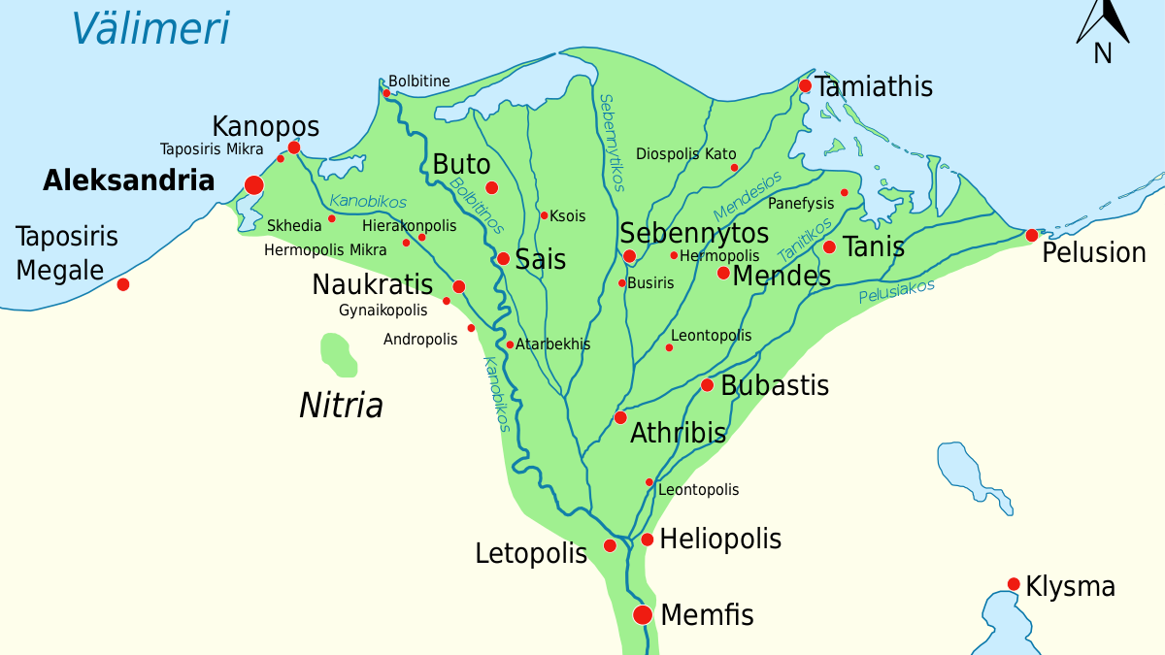
The Delta Plot

Slide 8
Pr₀(k lesions hits gene) = Convolution of
non-identical
Bernoulli RVs
gene size + lesion size
chromosome size
Pr₀(lesion hits gene) =
Null Model Assumptions
The lesion is uniformly likely to be observed anywhere on the chromosome.
The lesion size is fixed but its location is random.
Implication
Exome sequencing and other targeted sequencing methods violate the assumption because the lesion can only be observed in regions queried by the platform. P-values will exaggerate statistical significance.
Resolution
Map the lesion loci, gene loci, and chromosome size to a new coordinate system that includes only regions covered by the sequencing platform.
Null Model Assumptions
Under the null, each lesion has its own probability of hitting the gene.
Lesions are stochastically independent of one another.
Implication
Relapse tumors often retain many lesions of the diagnostic tumor. Clearly, these retained lesions are not stochastically independent of those in the diagnostic tumor. P-values will exaggerate statistical significance.
Resolution
Include each subject only once in an analysis. Perform separate analyses for diagnostic and relapse samples.

Slide 9
Genome-Wide GRIN
Perform this statistical test for each gene and each type of lesion.
For each type of lesion compute Pounds-Cheng (2006) q-values
q_{PC06} = min(1,2 mean(all p)) p_{BH95}
Estimates the proportion of tests with a true null hypothesis
E(p|null) ≥ 1/2
FDR adjusted p-value of Benjamini & Hochberg (1995)

Slide 10
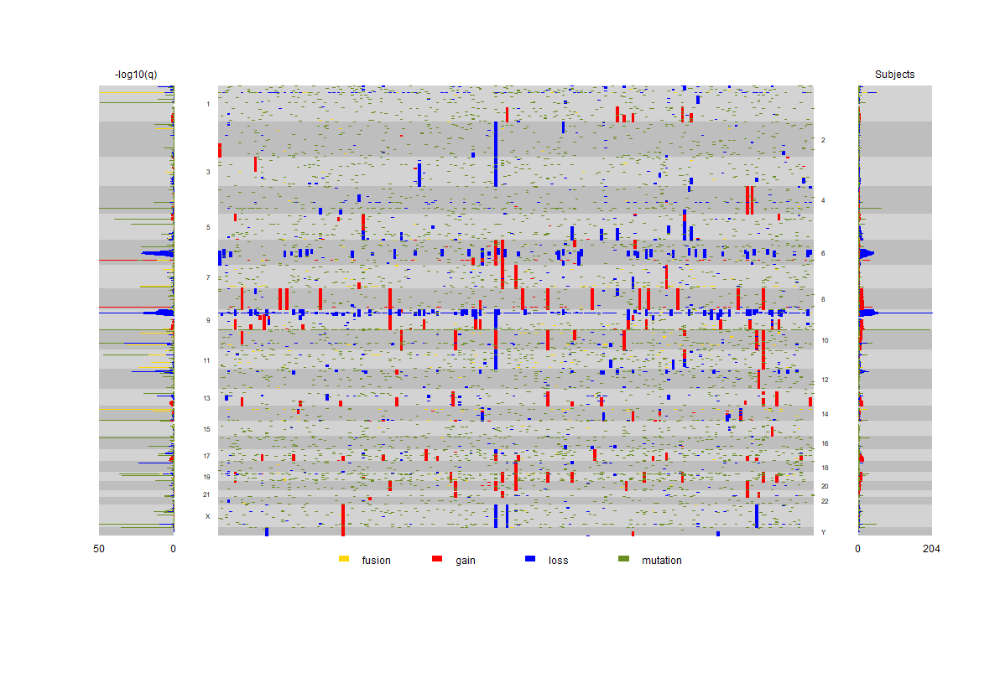

Slide 11
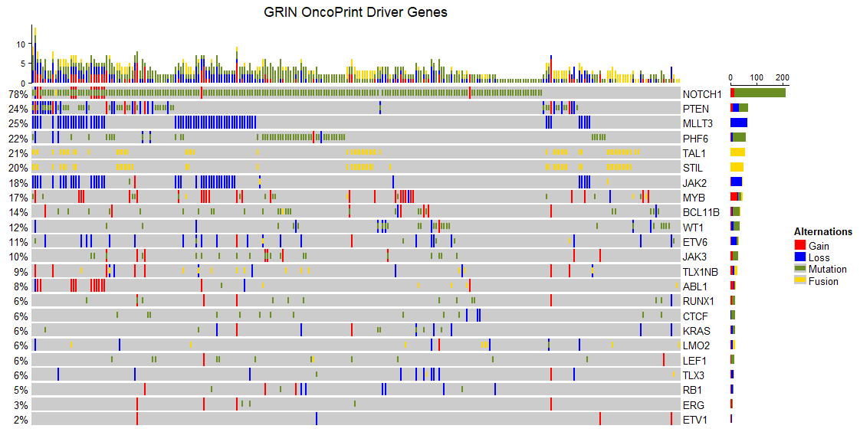

Slide 12
Constellation Test
Some genes may not be significantly affected by any one particular type of lesion.
But some genes may have an interesting cumulative pattern of being affected by two or more types of lesions, such as gain and mutation.
The constellation test evaluates whether a gene is significantly affected by at least k types of lesions.

Slide 13

freepik.com

Slide 14
Constellation Test
With data on k types of lesions, then each gene has k p-values.
For each gene, order those k p-values.
By the stochastic independence assumption, the p-values are independent.
The ordered p-values have a beta distribution of known form.

Slide 15
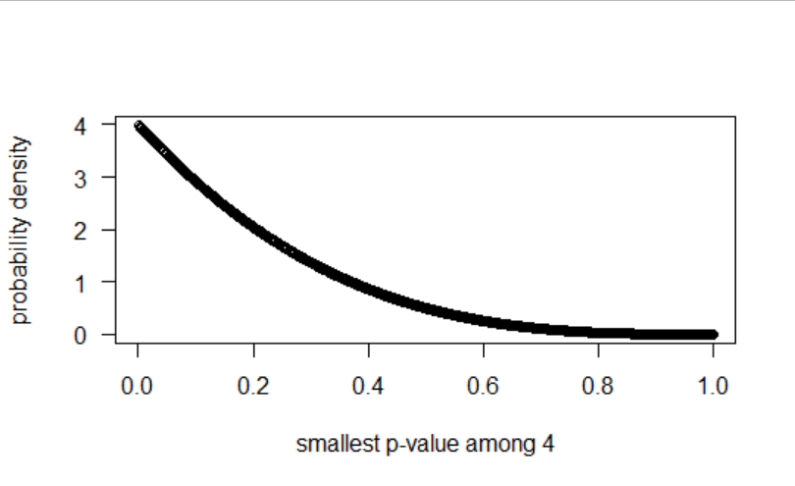
Under the null, it’s likely the smallest p-value among 4 p-values will be near 0.
Under the null,
it’s unlikely the smallest p-value among 4 p-values will be near 1.

Slide 16
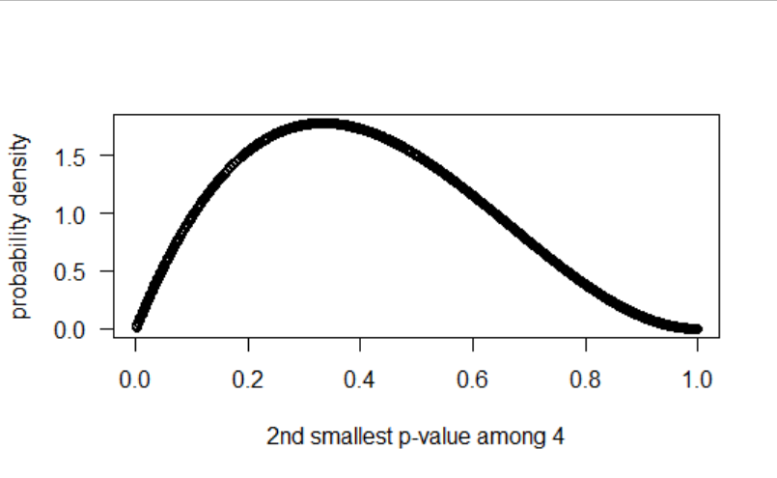
Under the null, it’s likely the 2nd smallest p-value among 4 p-values will be near 0.3.

Slide 17
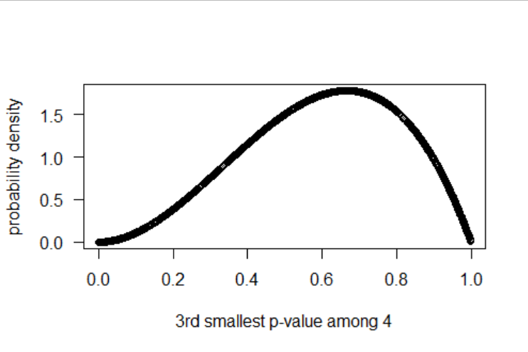
Under the null, it’s likely the 3rd smallest p-value among 4 p-values will be near 0.6.

Slide 18
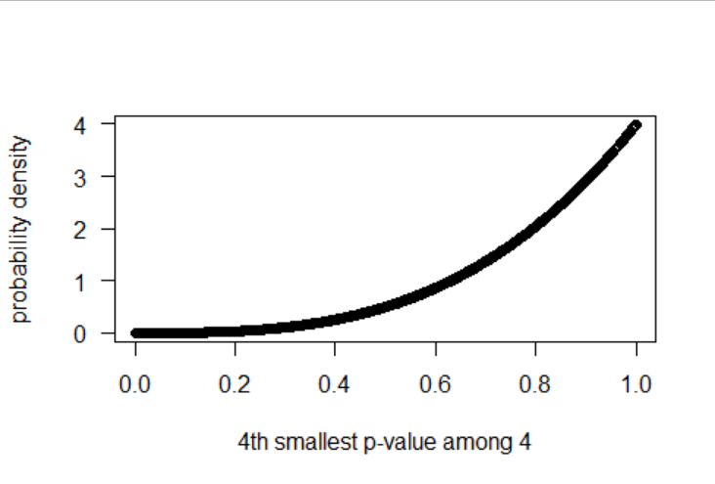
Under the null,
it’s likely the largest p-value among 4 p-values will be near 1.
Under the null,
it’s unlikely the largest p-value among 4 p-values will be near 0.

Slide 19
Suppose we have 4 p-values less than 0.10:
p₍₁₎ ≤ p₍₂₎ ≤ p₍₃₎ ≤ p₍₄₎ ≤ 0.10
Pr₀(p₍₄₎ ≤ 0.10) = 0.00001
That’s significant!

Slide 20
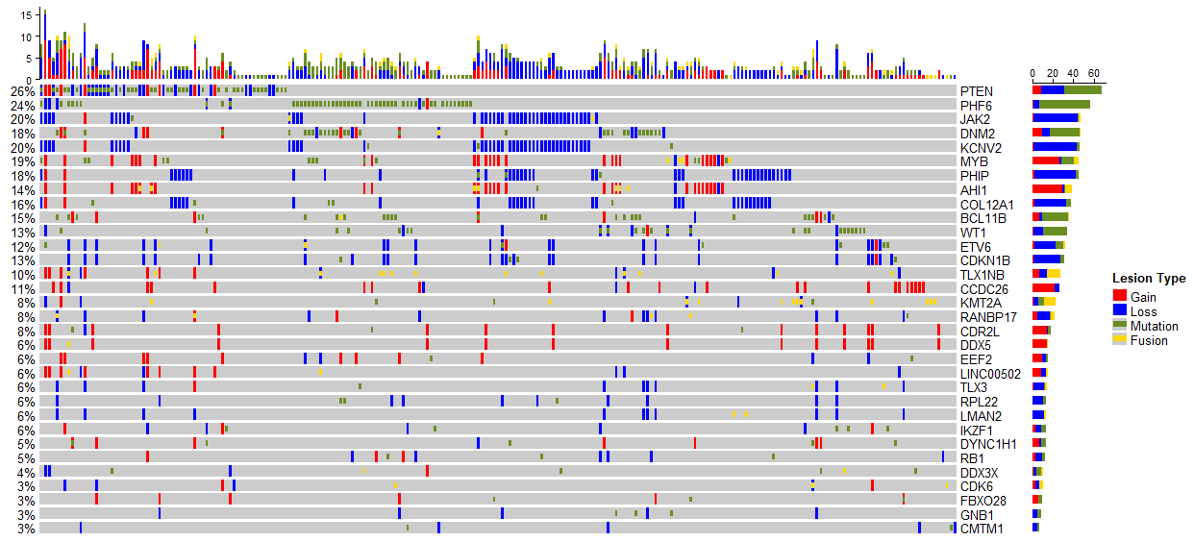
Significant Constellations of Two Lesion Types

Slide 21
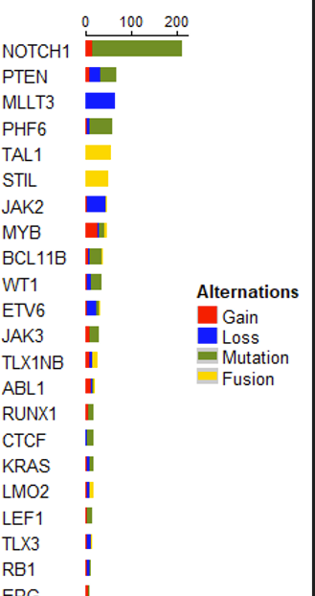
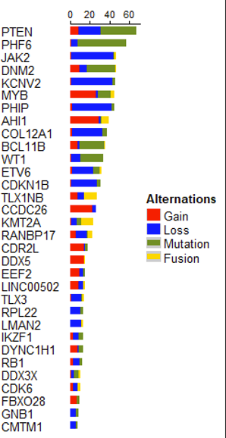
Significantly Impacted by one type of lesion
Significant constellation of two or more types of lesions

Slide 22
Associate Lesions with Expression (ALEX)
For each gene, categorize the subjects as follows:
No lesion in the gene
Hit by only one type of lesion (for each type of lesion)
Hit by multiple types of lesion (e.g., gain and mutation)
Use the Kruskal-Wallis rank-based procedure to test the null hypothesis that median expression is equal across the lesion categories.
Generate plots of lesion loci side-by-side with expression waterfall plots.

Slide 23
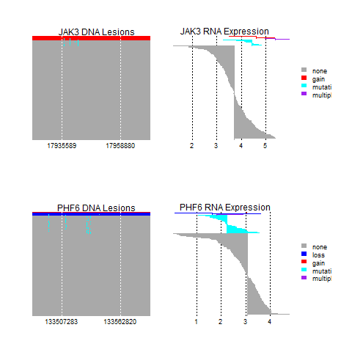
JAK3 Expression
None < Mutation < Gain < Gain + Mutation
PHF6 Expression
Loss < Loss + Mutation < Mutation < None

Slide 24
GRIN 2.0
Mutations
Increase Compute Speed > 100 fold
Gain/Loss/LOH
Fusions
Constellations
Simplified Programmer Interface
Expression
Clinical

Slide 25


